Slide 1
Do Something
By: Aliyah Warinner

Slide 2
How it started
I am very passionate about child starvation. I feel that people want to help, but don’t know how.
I had an idea on how to make a change and get people in the community involved

Slide 3
I talked to my cheerleading coaches about using all of our athletes and parents to do some good for the community
We worked out a calendar with multiple dates to go volunteer at different locations

Slide 4
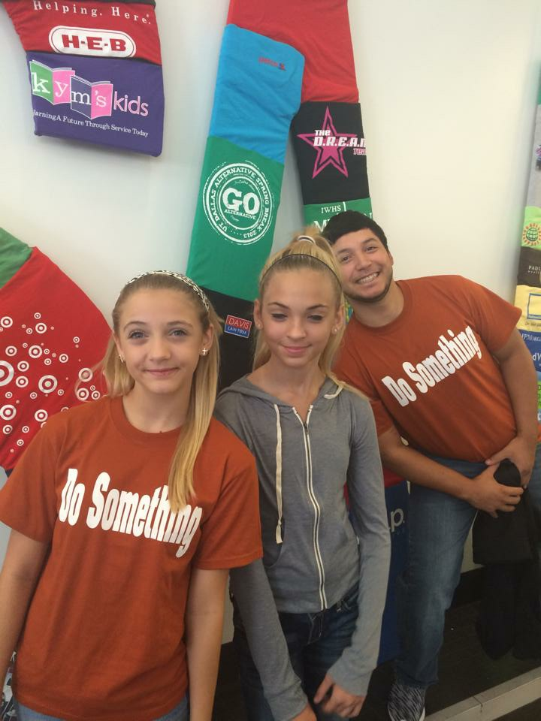
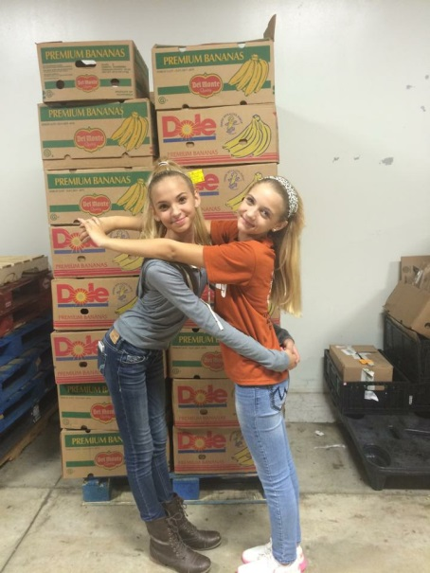
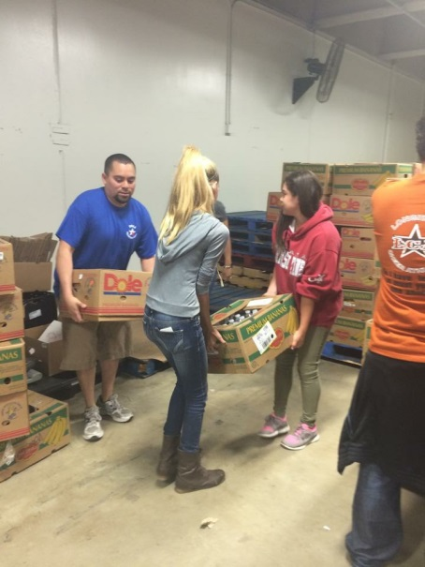
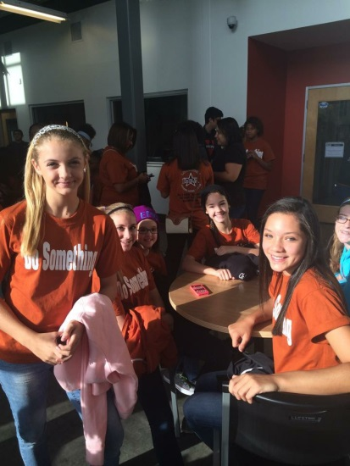
We visited the Sa Food bank, where we packed 17,379 lbs of food. That’s 13,377 meals! I really felt like we were starting to make a change, but we didn’t stop there…

Slide 5
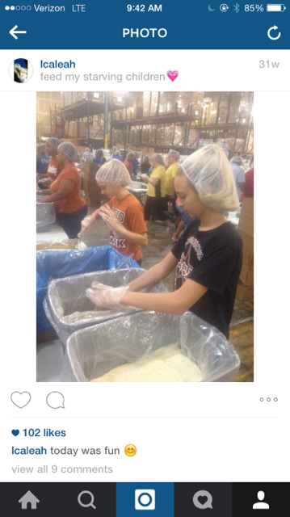
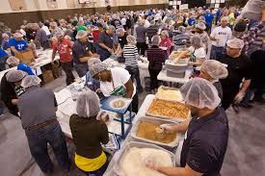
Next we visited the Feed Our Starving Children organization at the Children’s Hunger Fund twice. There we made food packs to send off to 3rd world countries who don’t have food available.

Slide 6
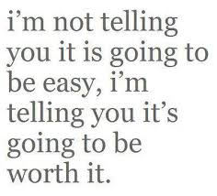
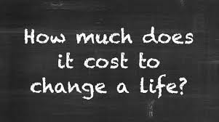
Now I spread awareness to make sure that everyone knows about this serious issue and how anyone can make a difference!
Starting with YOU

Slide 7
